Slide 1
UNIVERSITY OF TECHNOLOGY SYDNEY
42174 Artificial Intelligence Studio
ORAL DEFENCE
SyntaxSquad – Thursday Evening
🤟 WORD-LEVEL & POSE-BASED
SIGN LANGUAGE INTERPRETER
Empowering Deaf and Hard-hearing Community
Instructors:
Dr. Vahid Behbood
Xiaojie Lin (Zoe)
Ziyi Zhao (C)
25076833 – Hoang Quan Dang
24893063 – Hengky Edyson
25513918 – Antong Zhang
Notes:
Today, we're excited to present our project about the "Word-level & Pose-based Sign Language Interpreter". This is our AI for GOOD solution designed to bridge the communication gaps for the deaf and hard-hearing community.

Slide 2
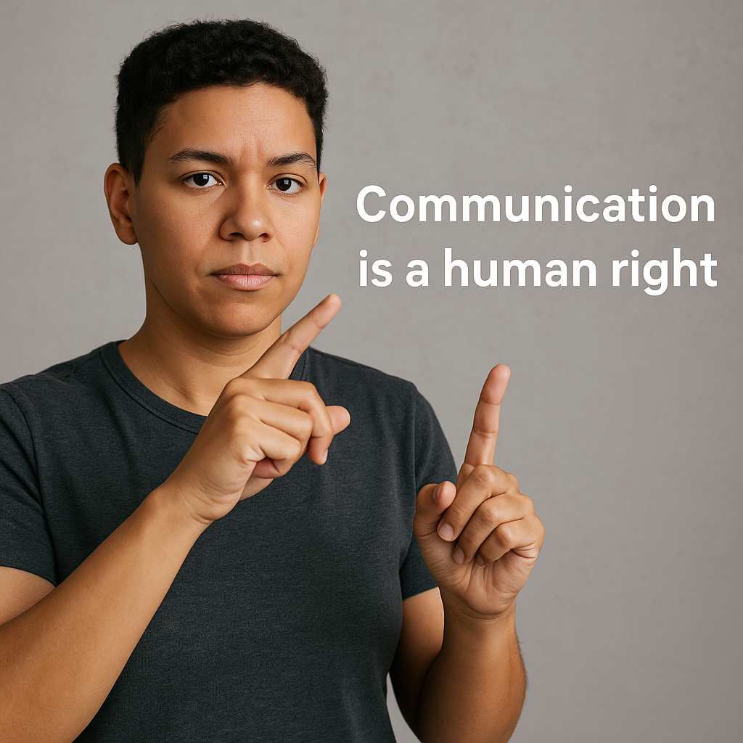
TABLE OF CONTENTS
1. Introduction 03
2. Project Impacts 04
3. Related Works 05
4. Methodology 08
5. Experimental Results 10
6. Challenges Faced 11
7. Conclusion 11
8. Future Works 11
Notes:
Let's dive into why this project matters, how we built it, what we've achieved, and the challenges we faced.

Slide 3
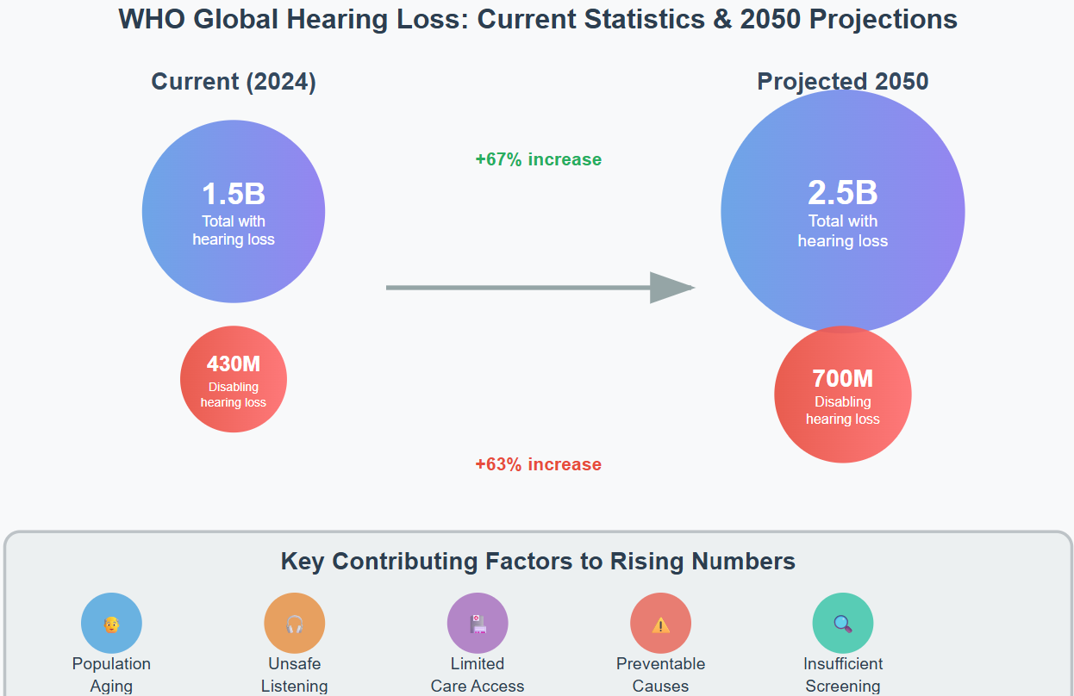
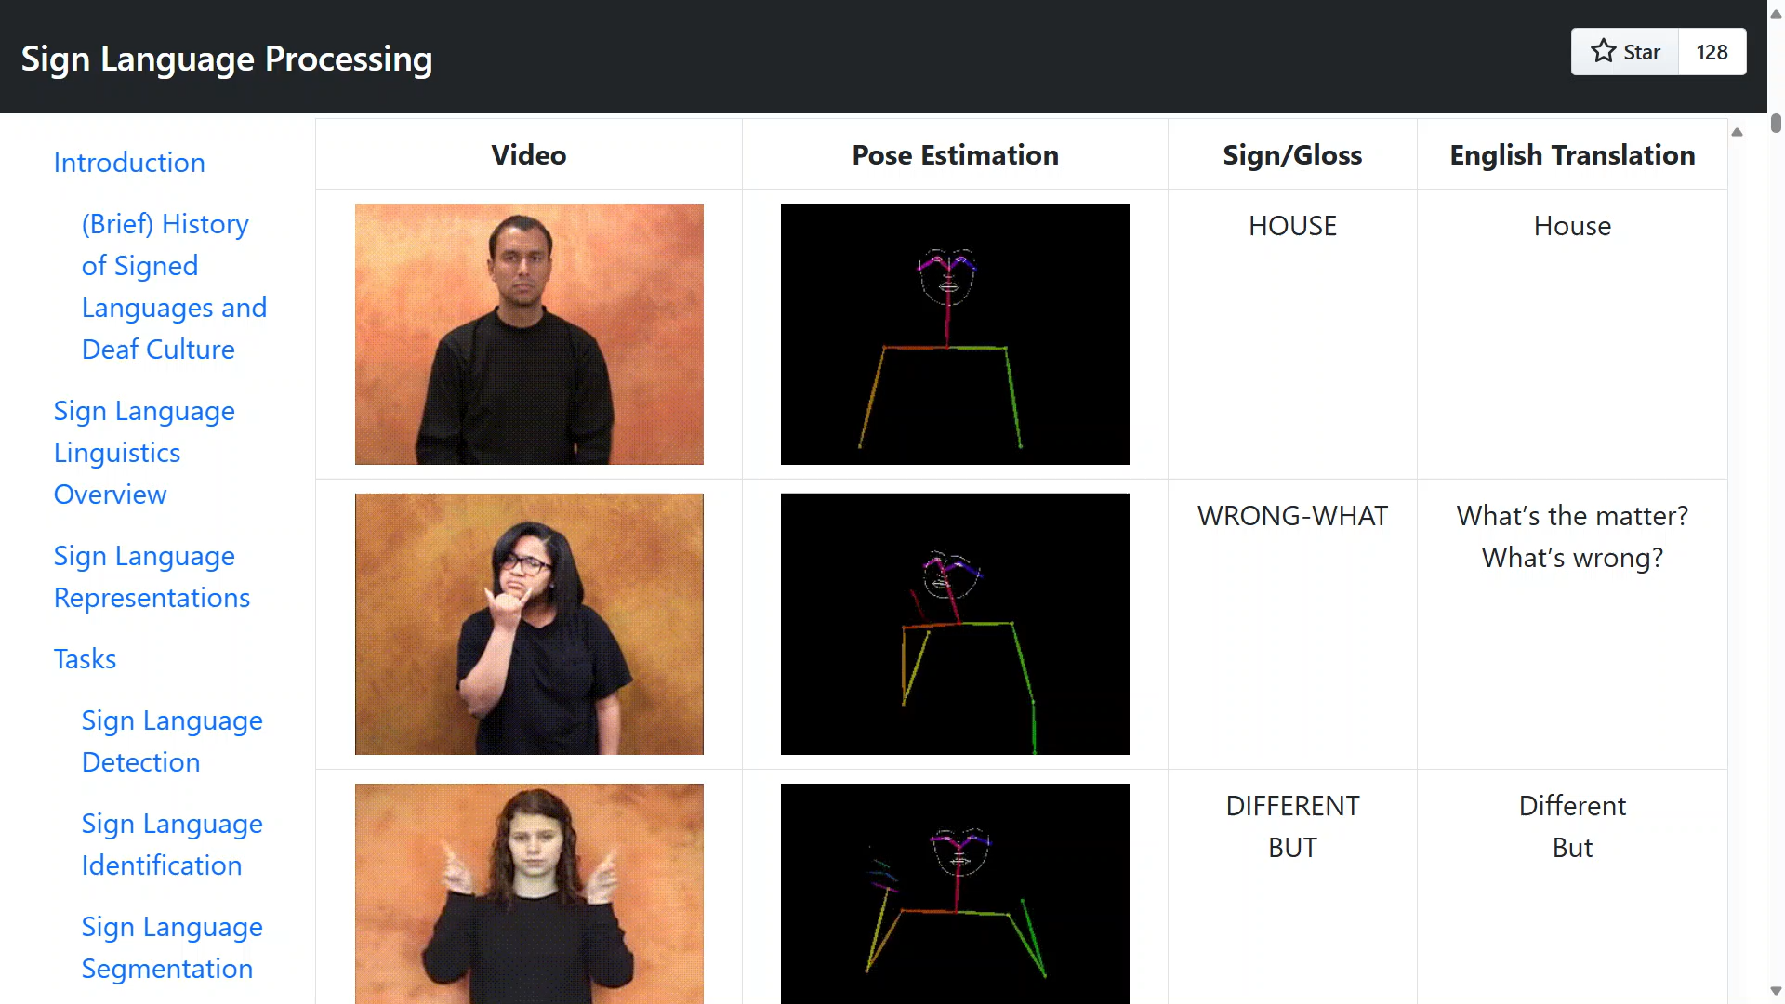
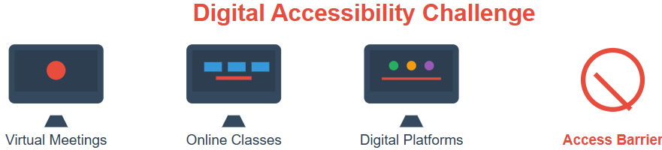
INTRODUCTION
World Health Organization (WHO, 2021)
+63% increase
Digital Accessibility Challenge
Sign language communication often requires specialized hardware (gloves, glasses), which is costly & inaccessible.
Access Barriers
Our Goal: Affordable, accessible, real-time translation for Sign Language, currently focused on American Sign Language (ASL)
Word-level & Pose-based Sign Language Interpreter
https://github.com/18520339/islr-mlops
Notes:
Communication is a fundamental human need but according to WHO, there are over 1.5 Billions people today experiencing some kinds of hearing loss, a number expected to rise to 2.5 Billions by 2050. The only way that these people use to communicate with the rest of the world is to use sign Language, a visual means of communication using hand gestures, facial expressions, and body movements.
And for these deaf individuals, digital spaces like virtual meetings or online classes often exclude them due to a lack of accessible tools. Additionally, many existing sign language translation solutions rely on specialized hardware like gloves or glasses, which is expensive and not widely accessible.
Our project aim to change that. You can imagine a world where deaf individuals can communicate seamlessly in any digital space without barriers. That's the vision we've worked for, using AI to make a real difference. Our goal was to create an affordable, accessible solution that translates American Sign Language into English text in real-time.

Slide 4

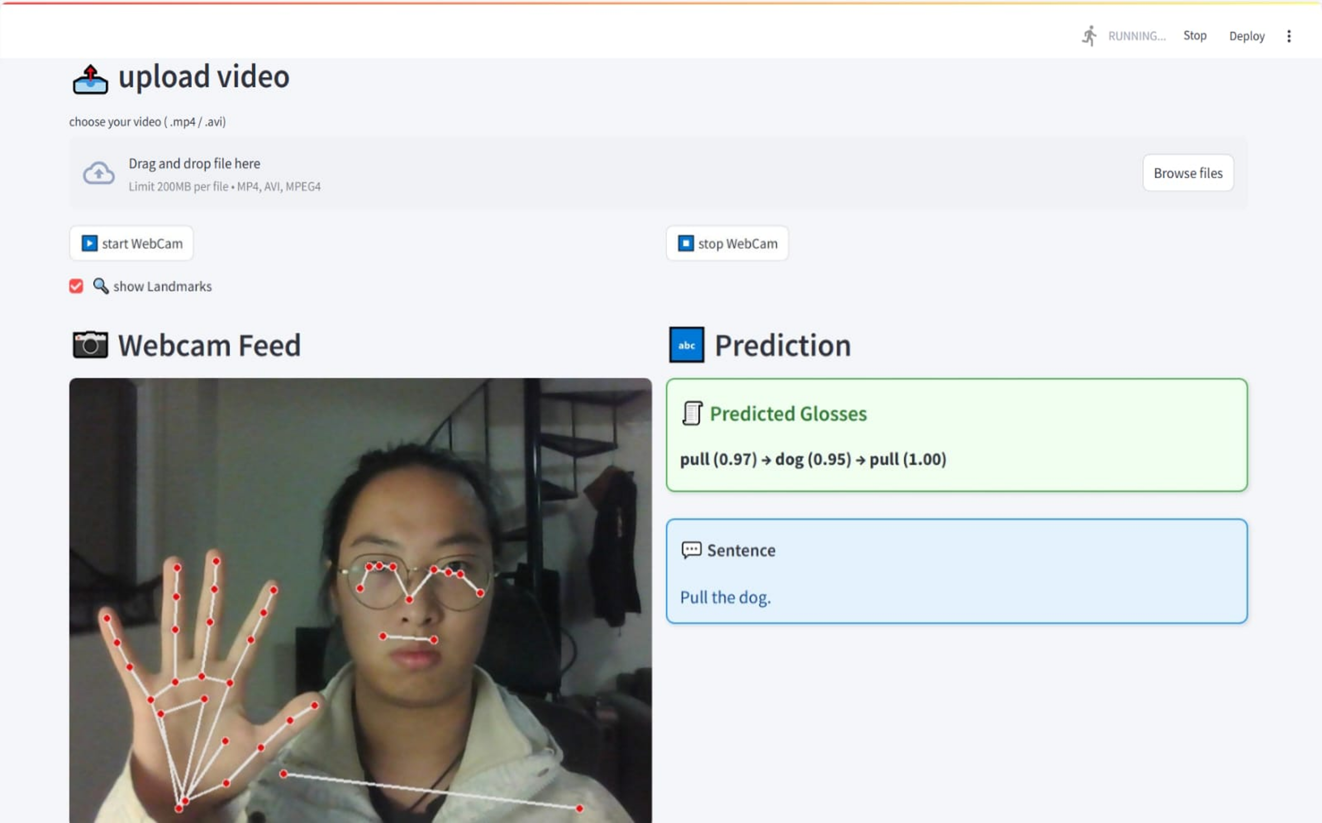
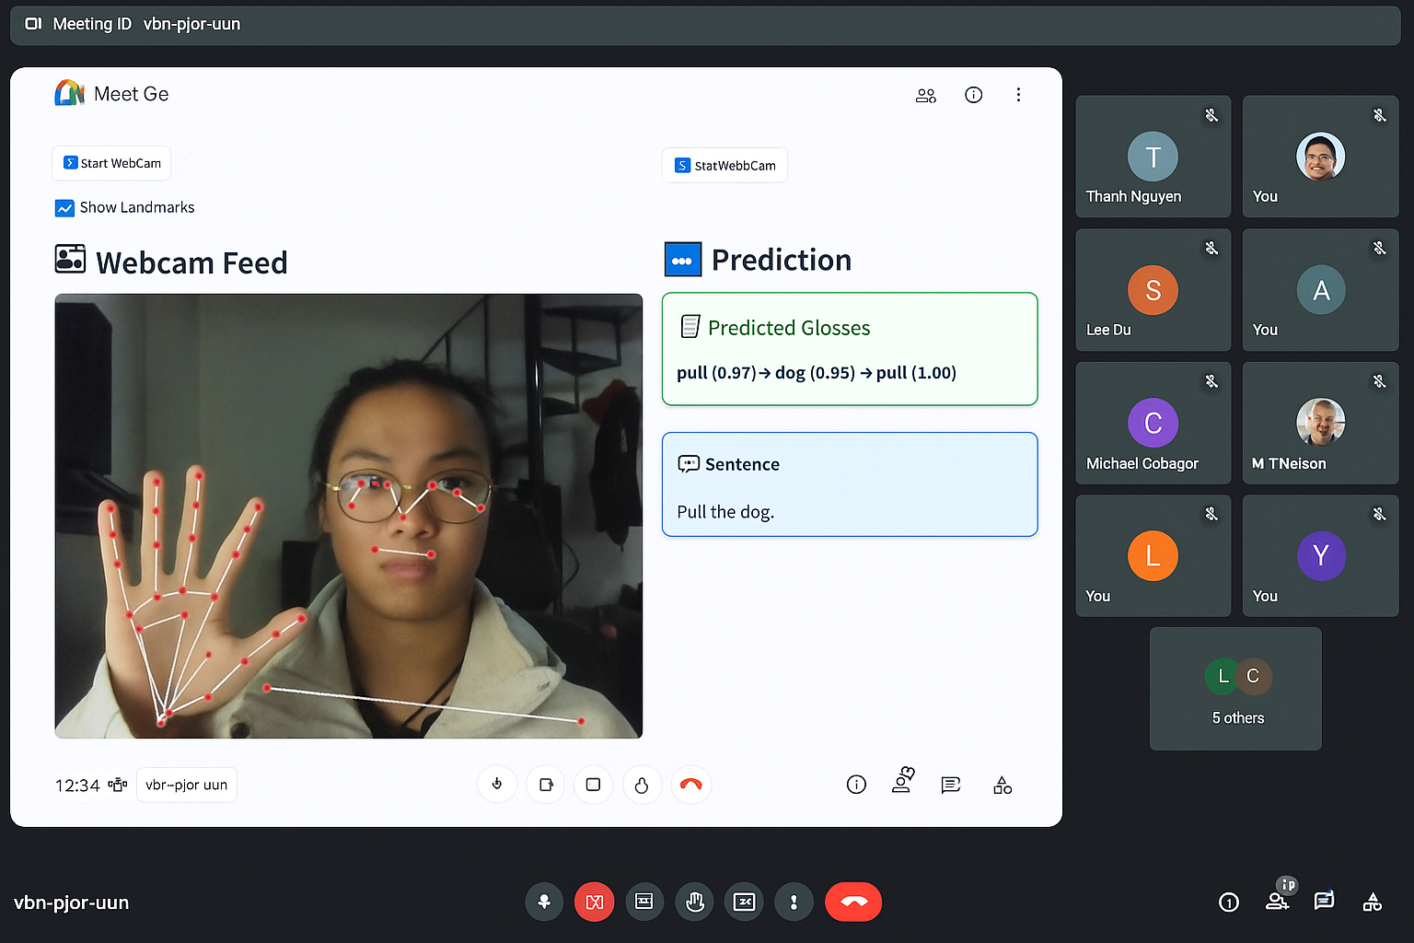

PROJECT IMPACTS
📷 Webcam is all you need
Promote Accessibility: No need for specialized hardware - uses any webcam. 🔓
Enhance Communication: Real-time captions for virtual meetings (e.g., Google Meet), education, work, and social settings. 💬
Beyond Fingerspelling: Capture true essence of Sign Language communication. 👐
Social Good: Reduce isolation, foster inclusion for the deaf community. 🌍
DEAF EMPOWERMENT
Word-level & Pose-based Sign Language Interpreter
https://github.com/18520339/islr-mlops
Notes:
So, what impact does our project bring about?
Firstly, it promotes accessibility by eliminating the need for specialized hardware. Here, any standard webcam can be used, making this solution cost-effective and widely available.
Secondly, it enhances communication by providing real-time captions, which can be integrated into platforms like Google Meet, used in social interactions, whether it's a virtual classroom, a job interview, or just a casual conversation with friends.
Thirdly, we focused on word-level, pose-based interpretation, going beyond simple fingerspelling for only alphabet characters like previous projects, to capture the true essence of sign language communication.
And most importantly, this project contributes to social good. By breaking down communication barriers, we reduce isolation and foster inclusion for the deaf community, empowering them to engage fully in a hearing world. We believe communication is a human right, and our project isn't just a tool, it is a step toward a more inclusive society.

Slide 5
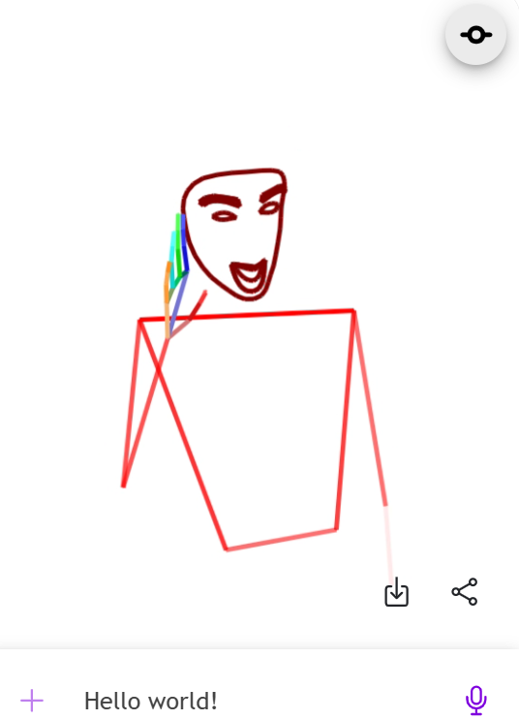
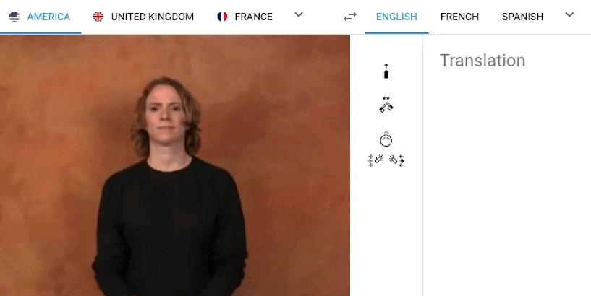
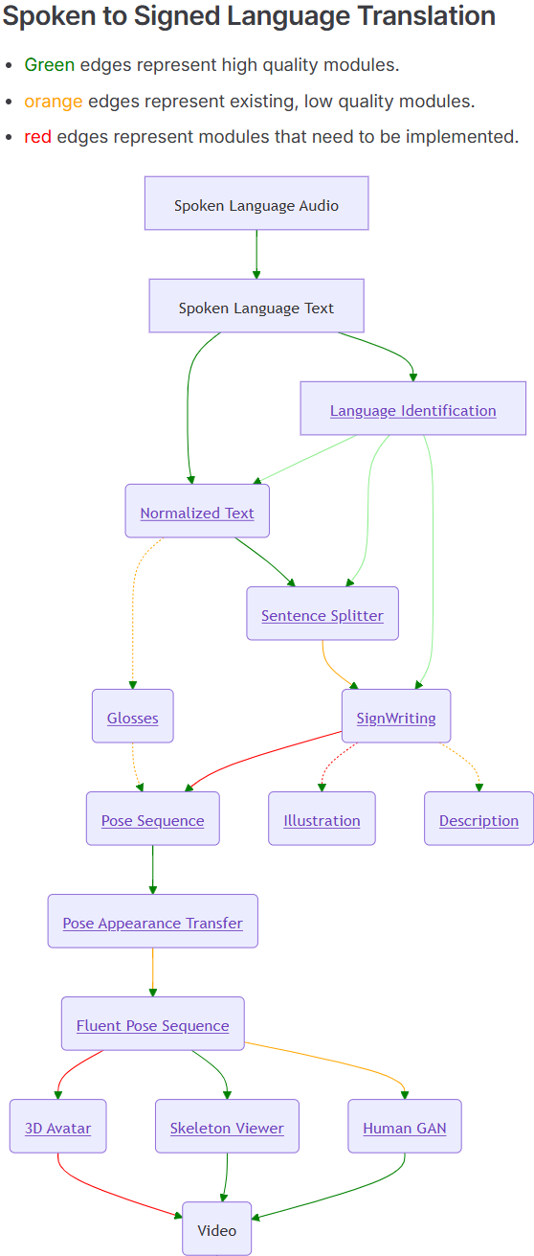
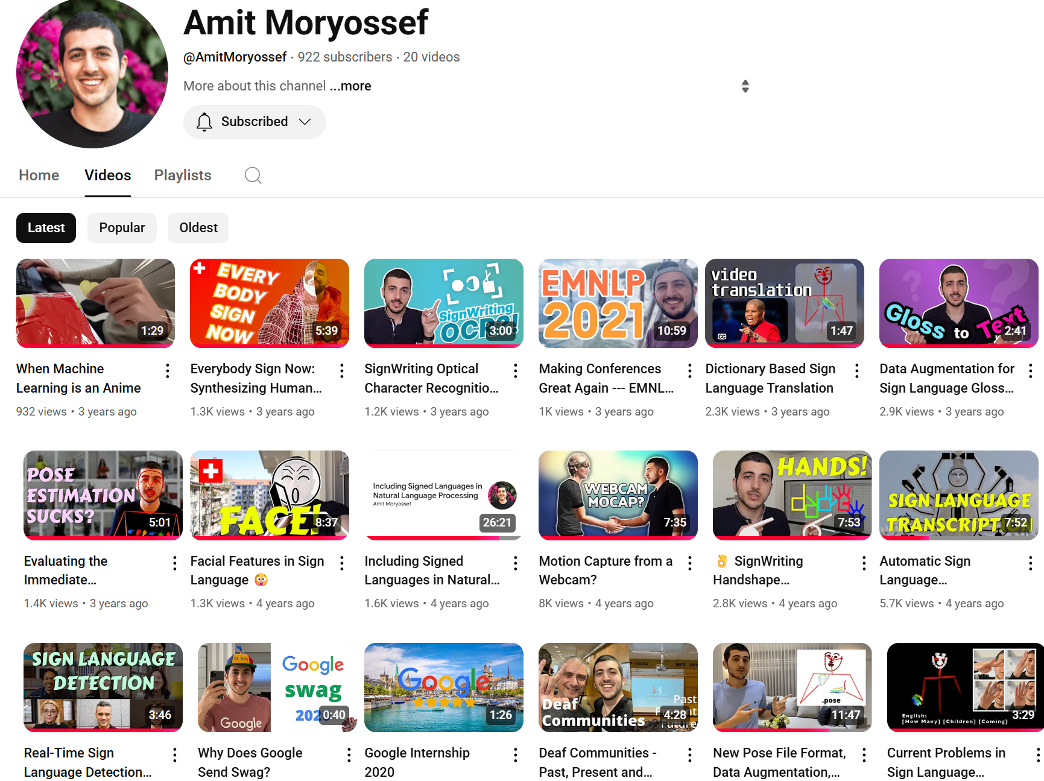
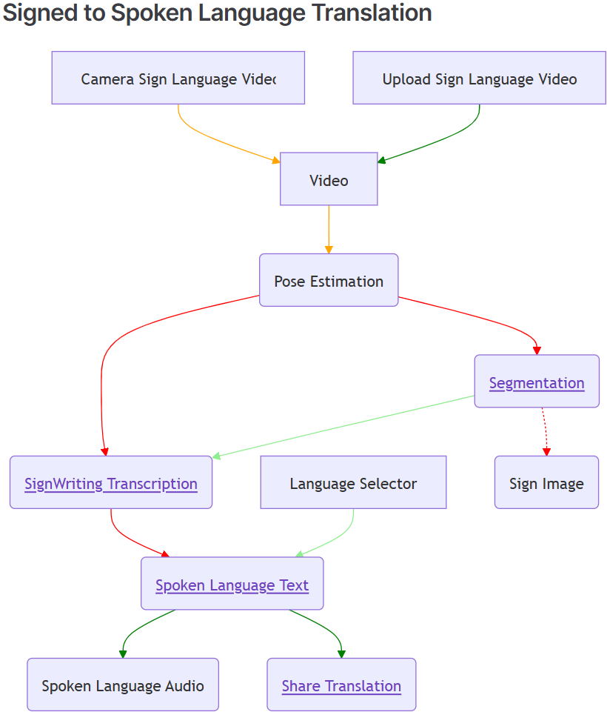
RELATED WORKS
Word-level & Pose-based Sign Language Interpreter
https://github.com/HengkyUTS/SyntaxSquad

Slide 6
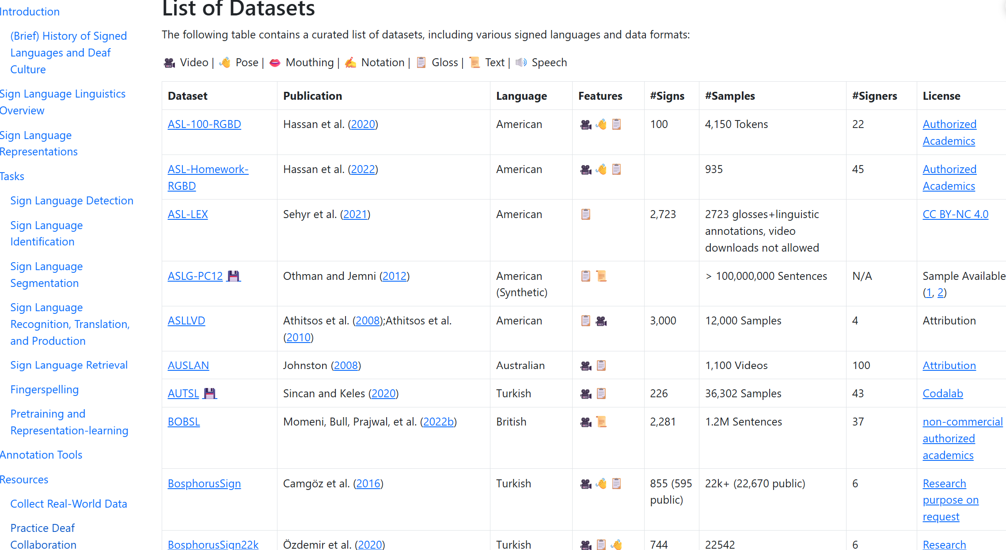
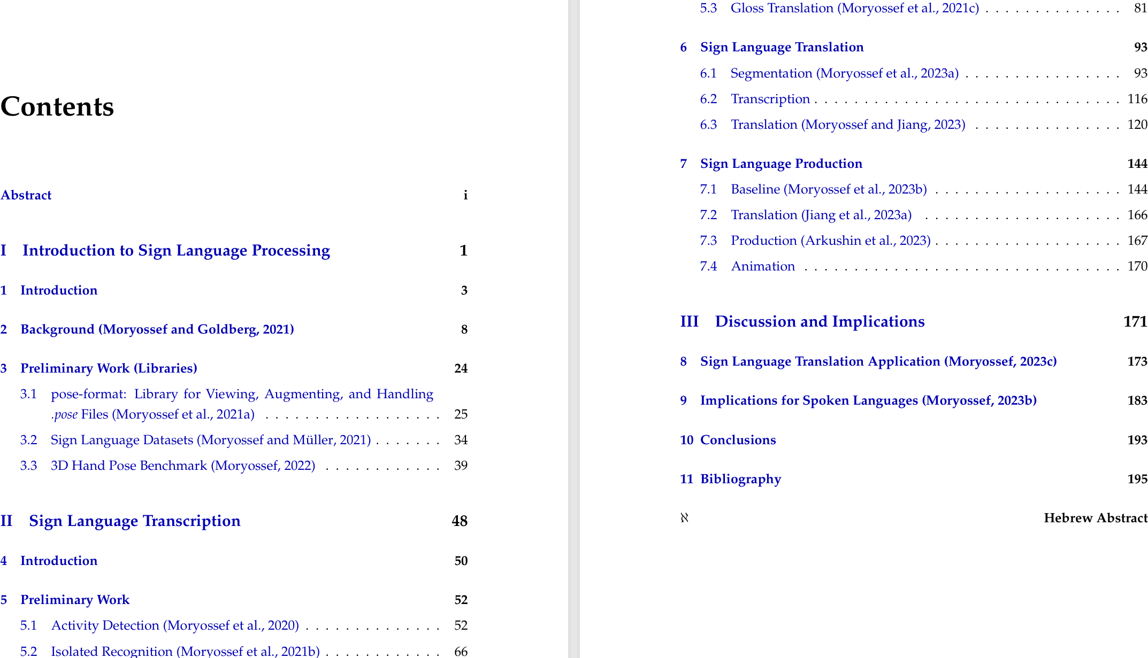
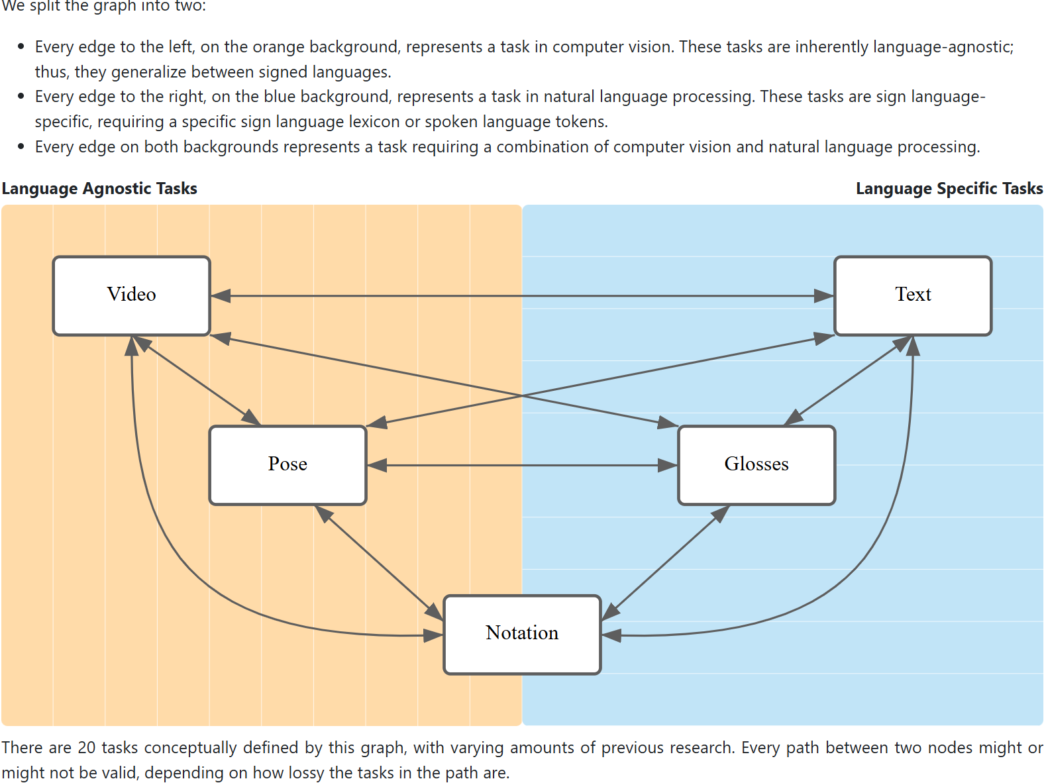
RELATED WORKS
https://research.sign.mt
https://sign.mt/docs/docs
https://github.com/sign/translate
https://github.com/sign-language-processing
Moryossef, A. (2024). Real-Time Multilingual Sign Language Processing. https://doi.org/10.48550/arxiv.2412.01991
Word-level & Pose-based Sign Language Interpreter

Slide 7
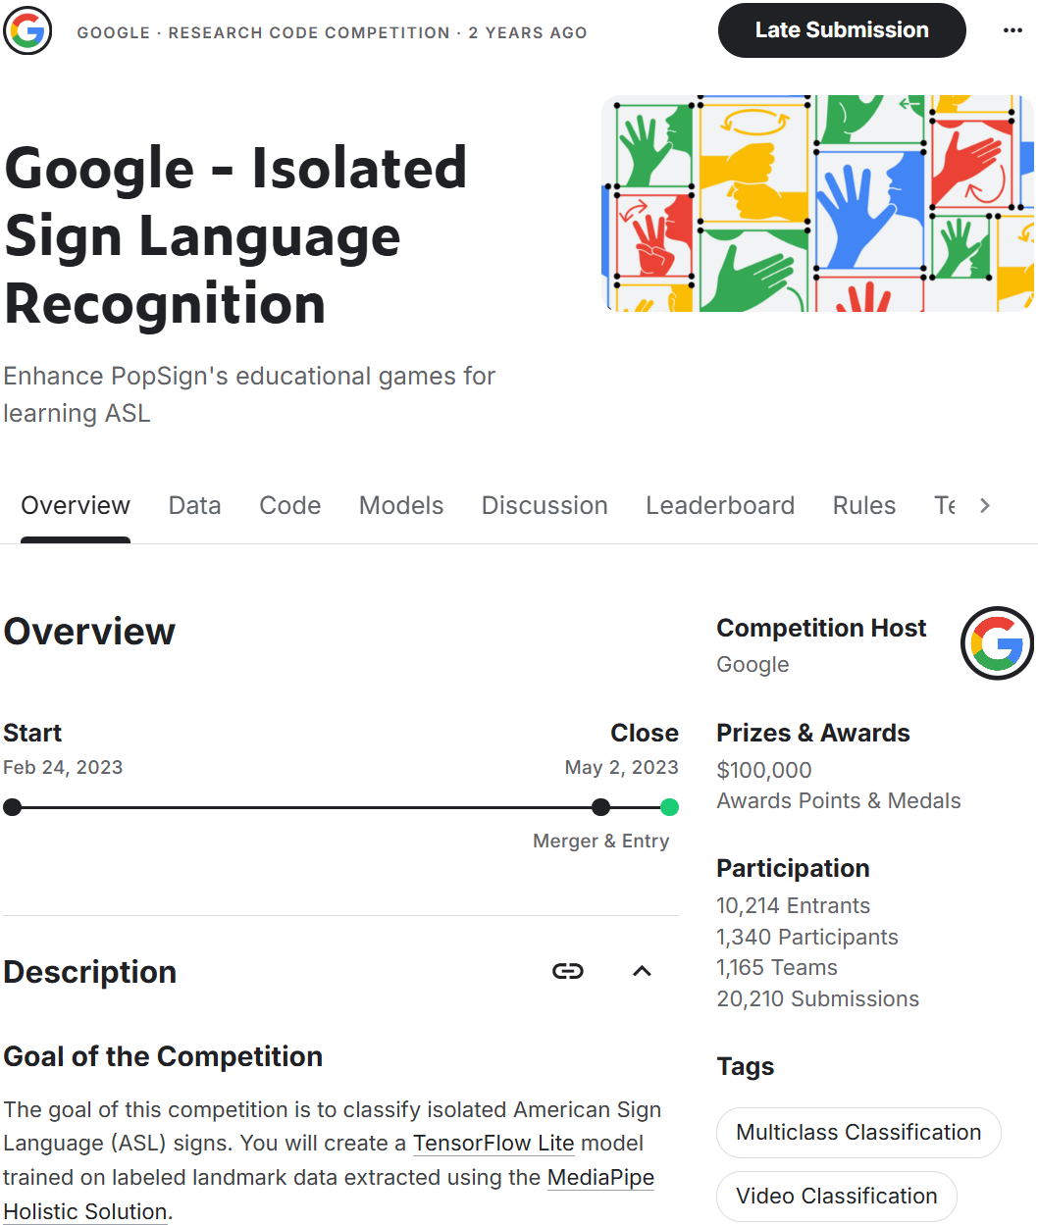
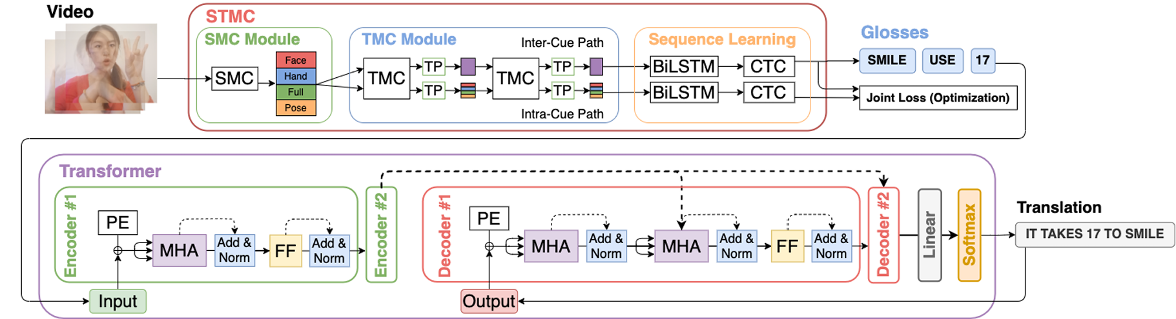
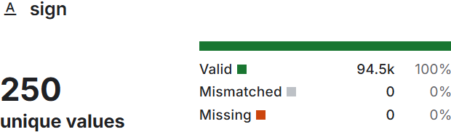
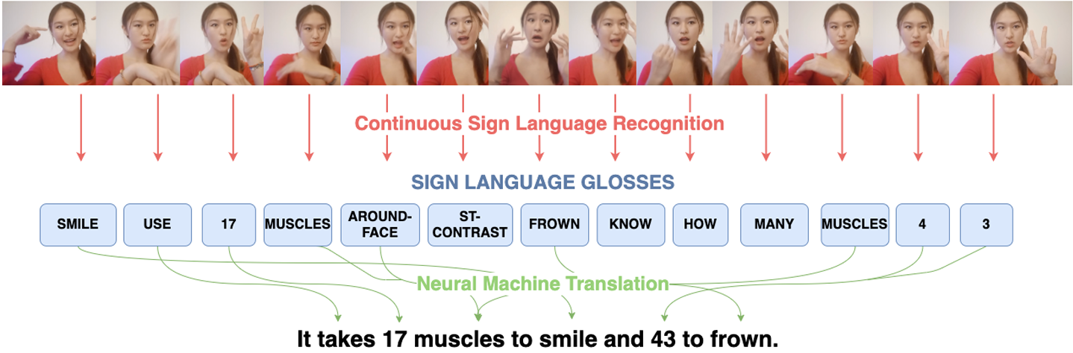
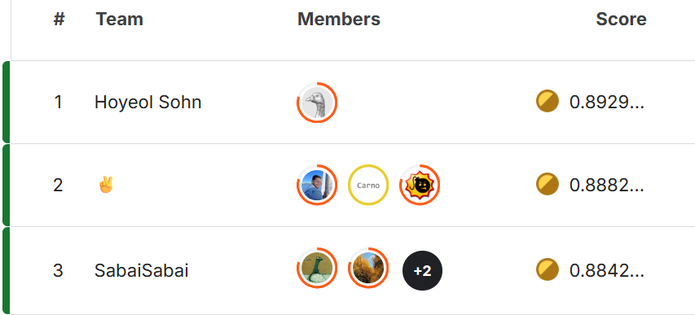
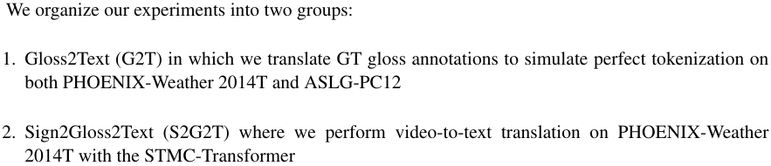
RELATED WORKS
https://www.kaggle.com/competitions/asl-signs
Yin, K., & Read, J. (2020). Better Sign Language Translation with STMC-Transformer. https://doi.org/10.48550/arxiv.2004.00588
Word-level & Pose-based Sign Language Interpreter
https://github.com/HengkyUTS/SyntaxSquad
Notes:
Works like STMC-Transformer addressed a problem quite similar to ours: Sign Language Recognition and Sign Language Translation.
They used a Spatial-Temporal Multi-Cue or STMC network to extract features from multiple visual cues (face, hand, full-frame, pose) and a Transformer network for sequence learning and translation.
The problem is that their STMC is for video-to-text translation, unlike our approach, Pose-to-text, for easier processing. Moreover, it is not open-source, so we can't have a look for customization.
A significant milestone occurred when I discovered the Google Isolated Language Recognition (GISLR) competitions on Kaggle, where participants utilized landmark data extracted from MediaPipe to predict approximately 250 glosses. I decided to adopt the best solution from this competition for my used dataset.

Slide 8
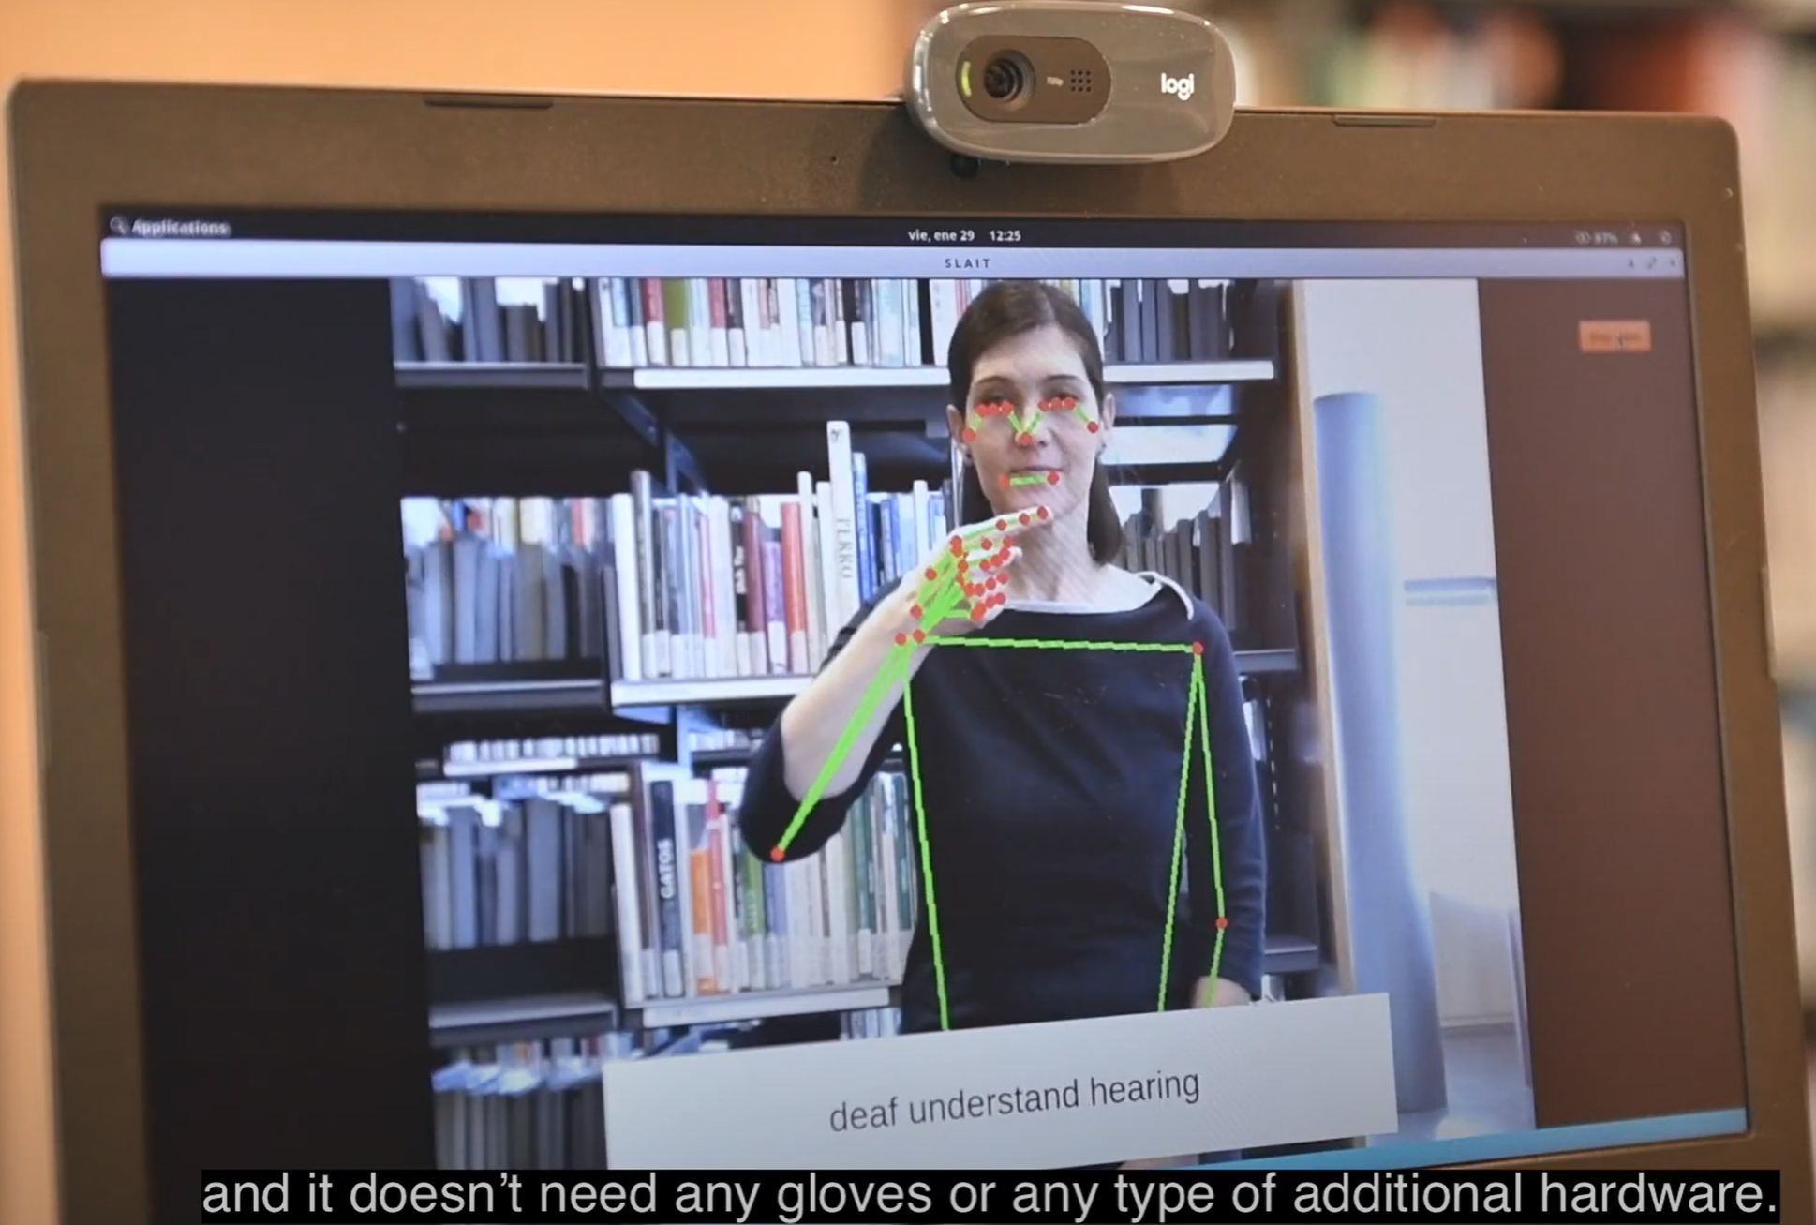
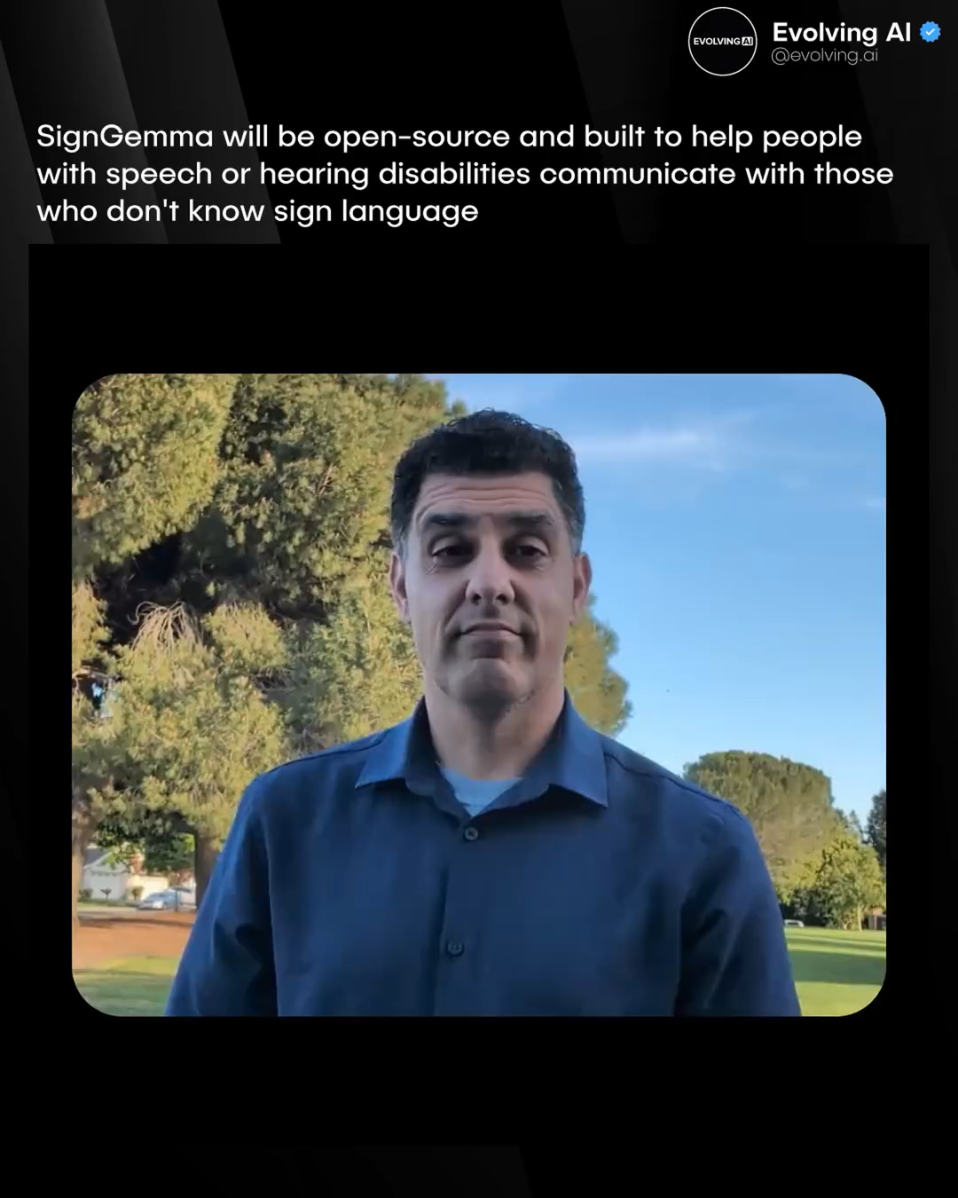
RELATED WORKS
https://www.youtube.com/@slait_ai
Word-level & Pose-based Sign Language Interpreter
https://github.com/18520339/islr-mlops

Slide 9
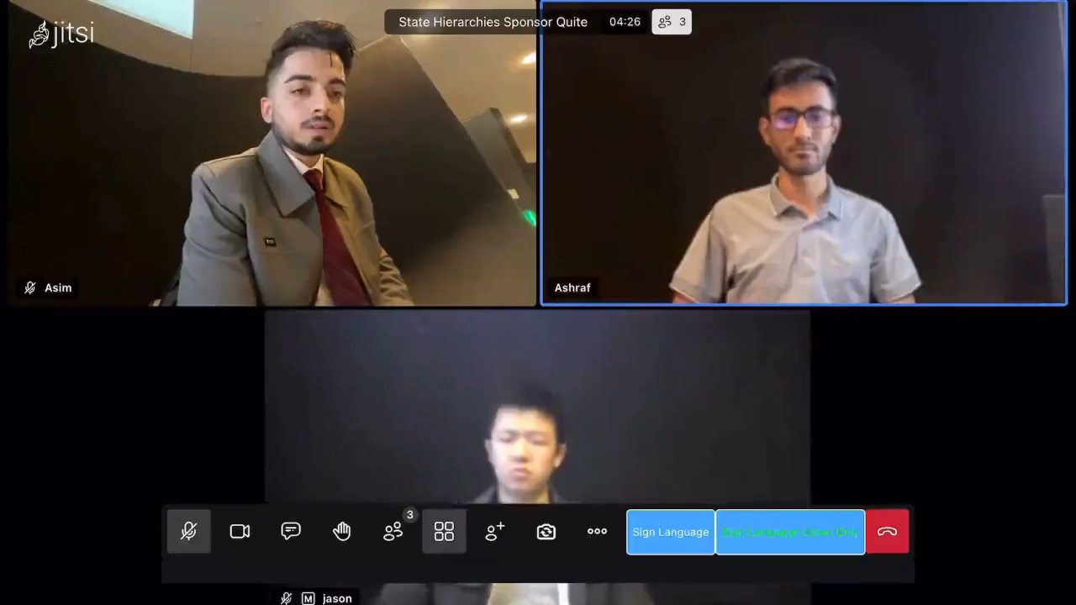
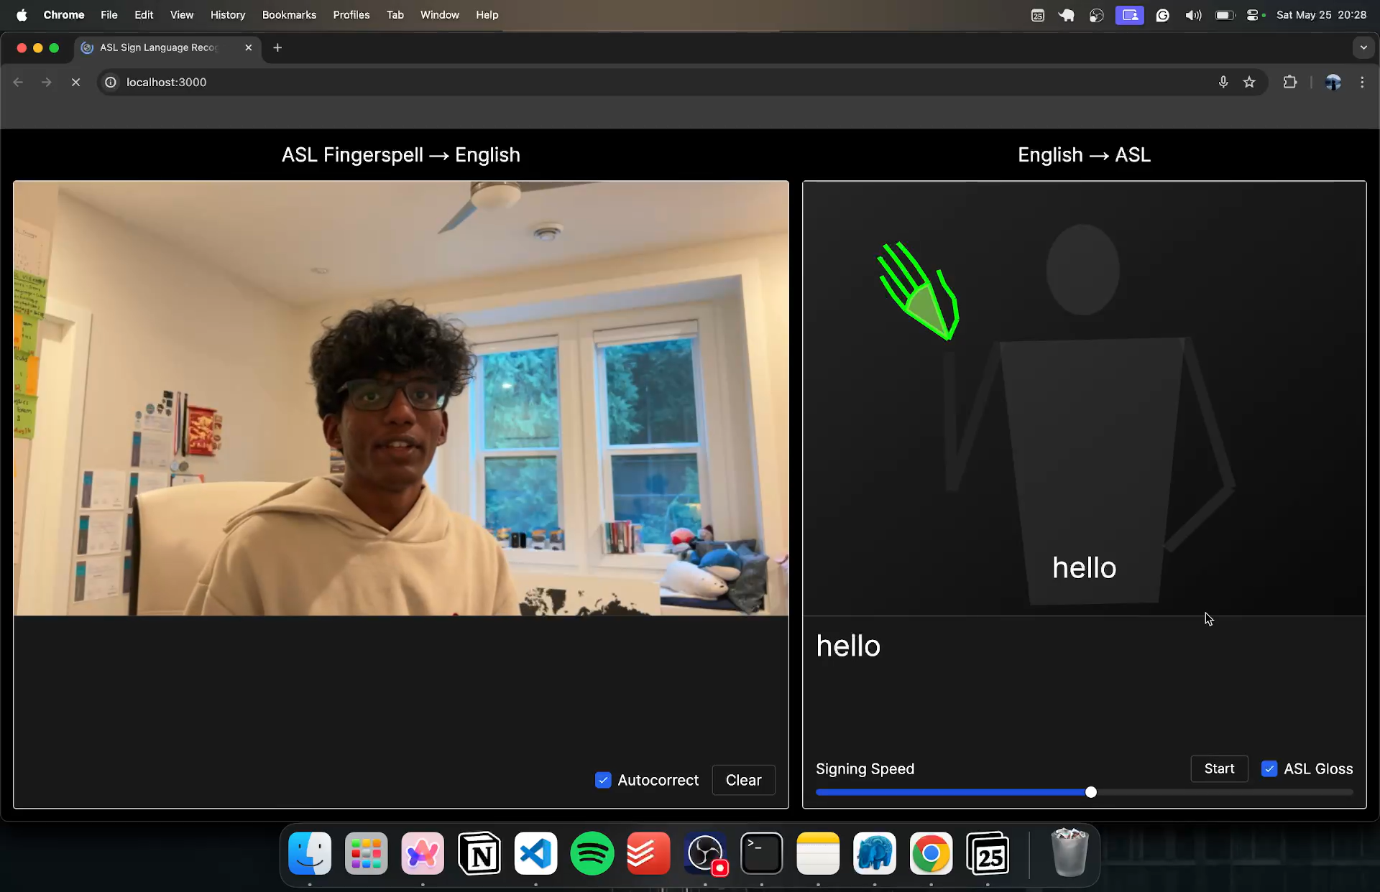
RELATED WORKS
https://github.com/jason2134/SignSync
https://github.com/kevinjosethomas/sign-language-processing
Word-level & Pose-based Sign Language Interpreter
https://github.com/18520339/islr-mlops

Slide 10
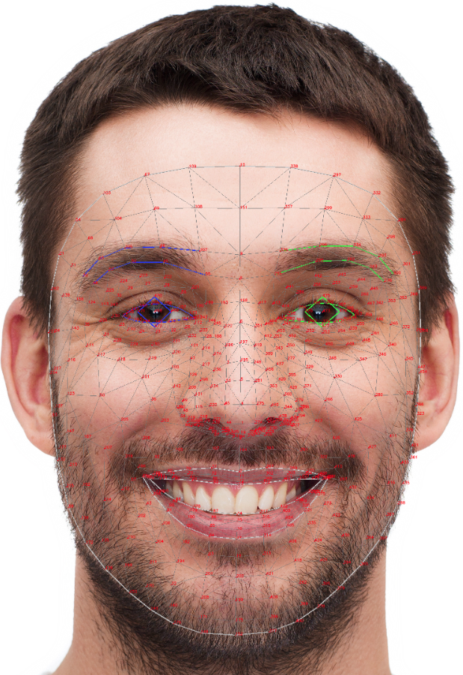
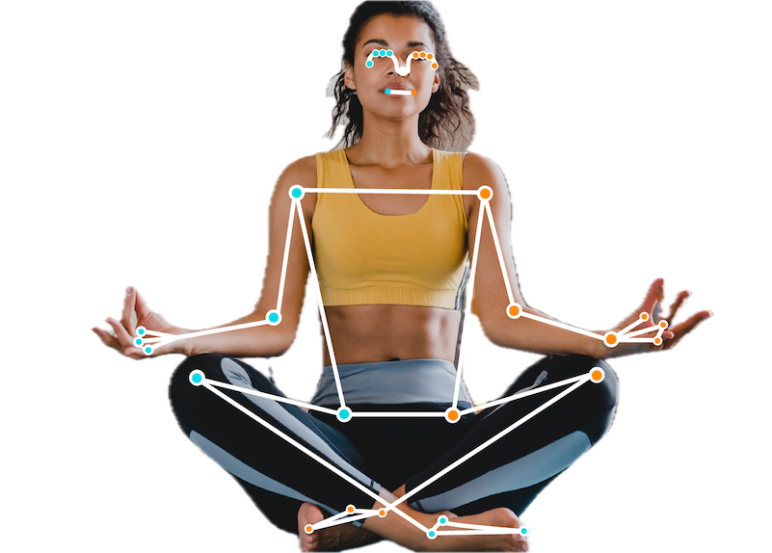
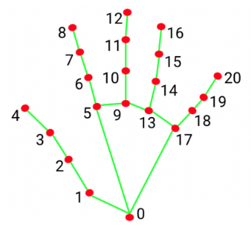
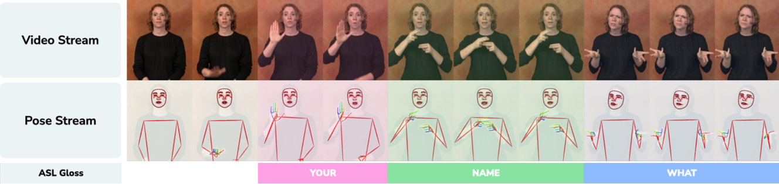
METHODOLOGY
132 Landmarks on FACE
21 Land Landmarks/Hand
6 Body Pose Landmarks
TOTAL OF 180 landmarks USED
Word-level & Pose-based Sign Language Interpreter
https://github.com/18520339/islr-mlops
Notes:
I'll walk you through our solution. Our interpreter takes a video of someone signing in ASL, processes it, and outputs natural English captions in real-time; all using just a standard webcam. Here's how it works:
- First, instead of processing heavy video data we take a pose-based approach. We capture video from the webcam and use Google's technology called MediaPipe to extract 180 lightweight landmarks per frame, focusing on hands, upper body, and facial features. This approach is not only faster but also robust against diverse conditions like varying backgrounds or skin tones, ensuring reliable performance in diverse settings.

Slide 11
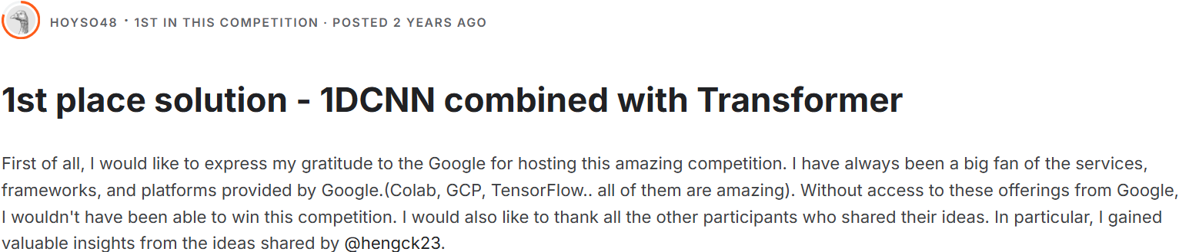
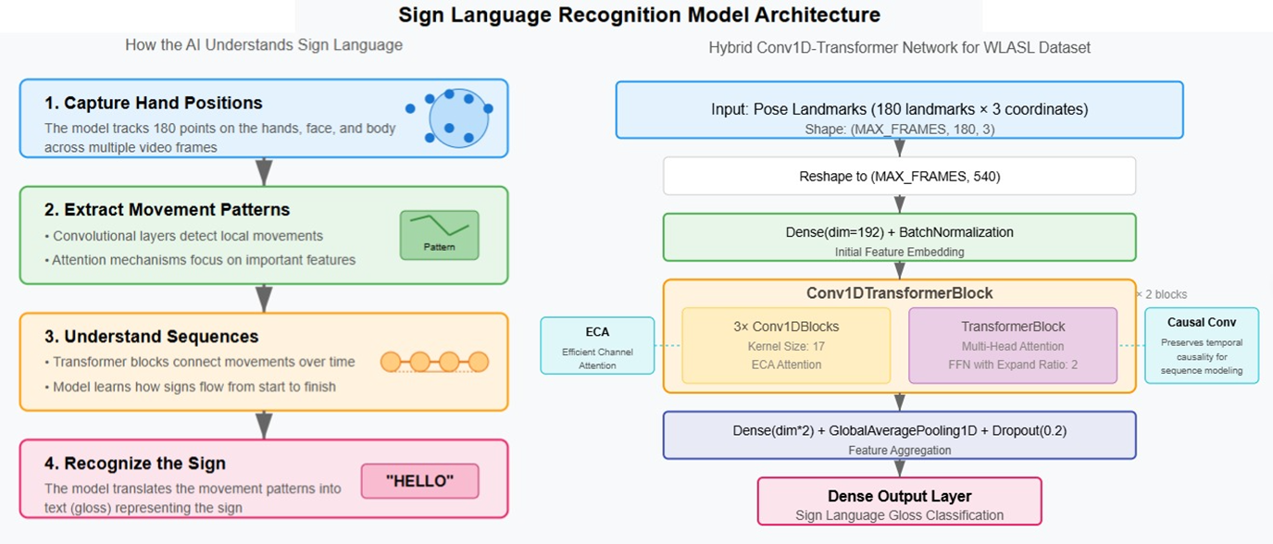
METHODOLOGY
POSE-TO-GLOSS STAGE
Word-level & Pose-based Sign Language Interpreter
SyntaxSquad
Notes:
- Next, we adapted a Convolutional Transformer-based model, the best solution from the GISLR competition to predict glosses (a written representation of an individual sign), like "MOTHER" or "LOVE", achieving a top-5 accuracy of 86%.

Slide 12
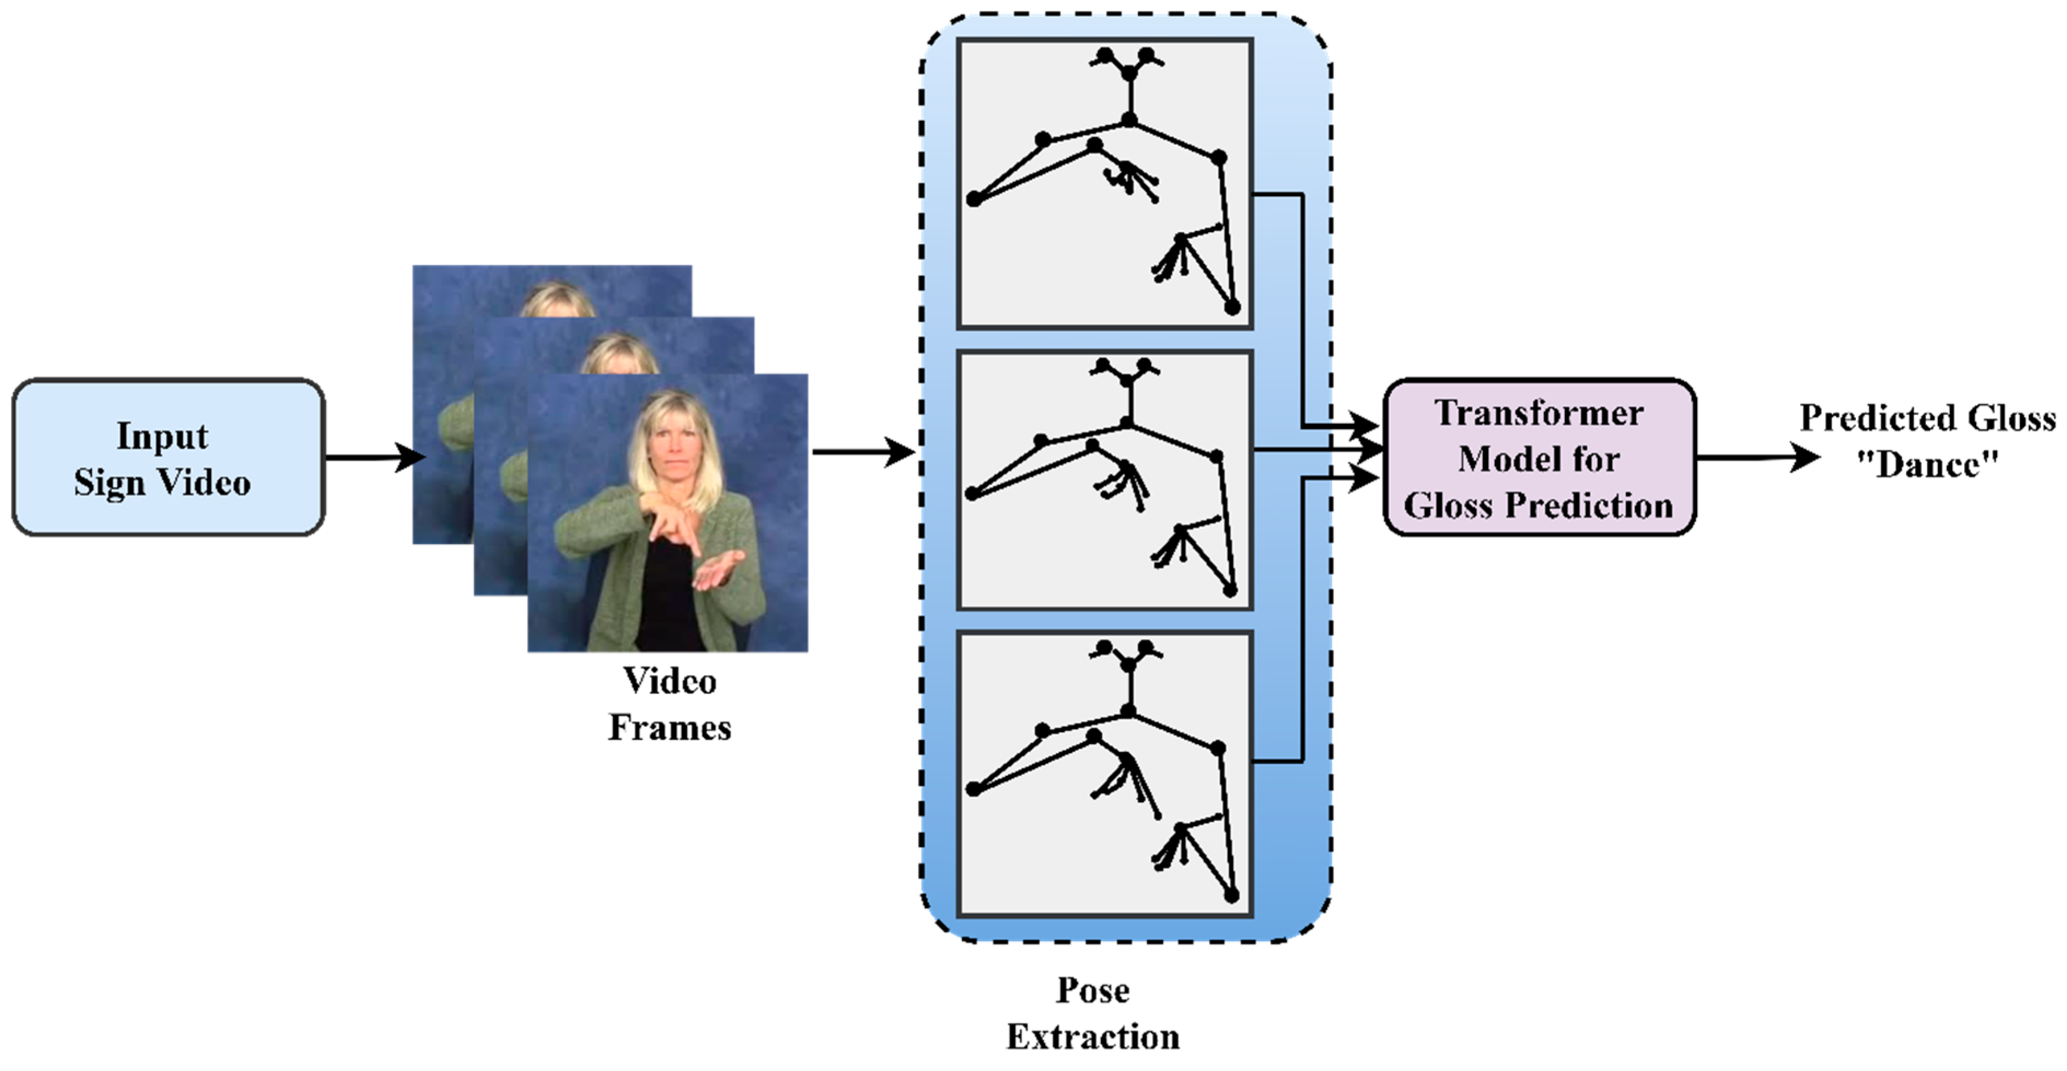
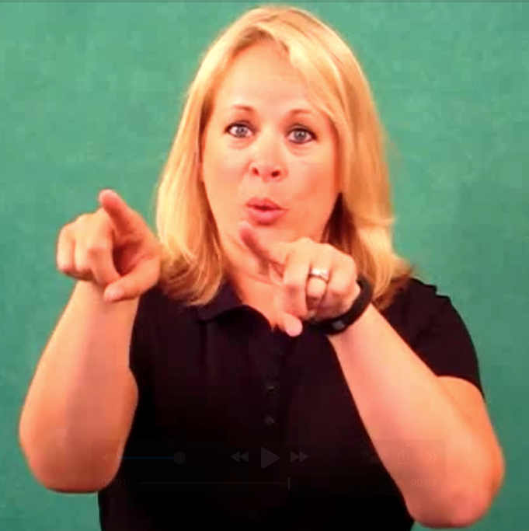

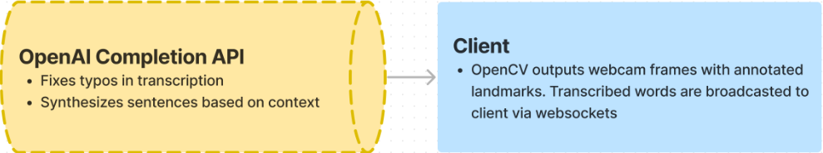
METHODOLOGY
GLOSS-TO-TEXT STAGE
"Go"
GPT-4o Mini
"Let's go dance"
Word-level & Pose-based Sign Language Interpreter
https://github.com/18520339/islr-mlops
Notes:
- Then, we pass these gloss predictions to an Gloss-to-Text module, which uses GPT-4o-mini to translate them into natural English sentences, such as "Mother loves her family".
ASL's unique syntax posed a challenge. Glosses don't directly map to English sentences. They often lack articles and follow a topic-comment structure. We tackled this by designing a smart prompt for GPT-4o-mini, allowing it to form a meaningful combinations from multiple gloss predictions, resulting in more natural translations.

Slide 13
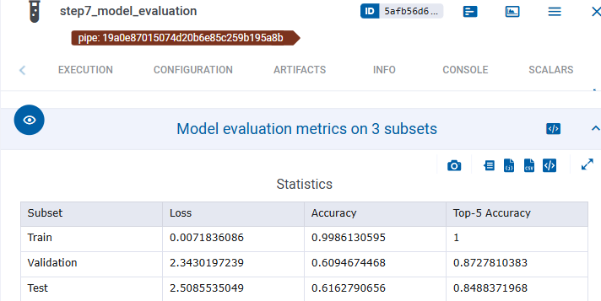
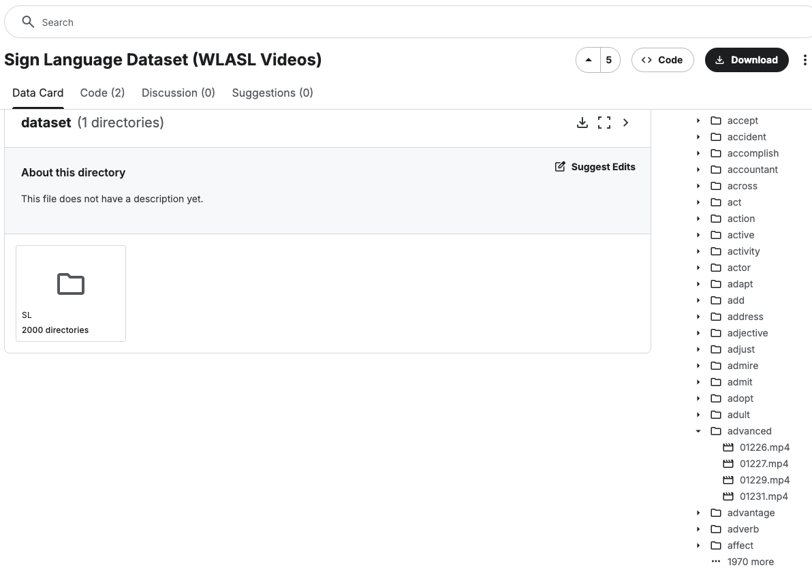
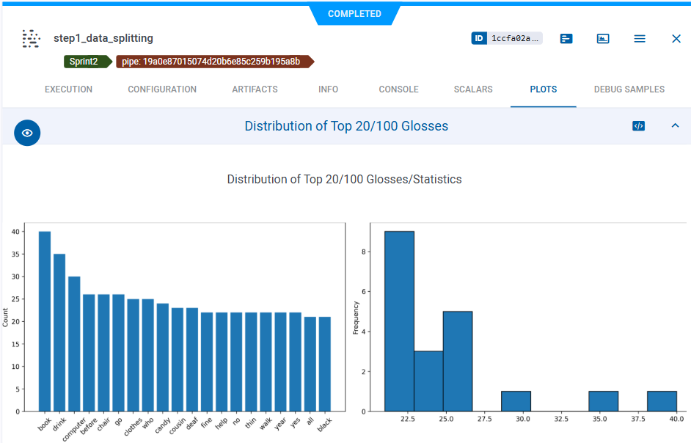
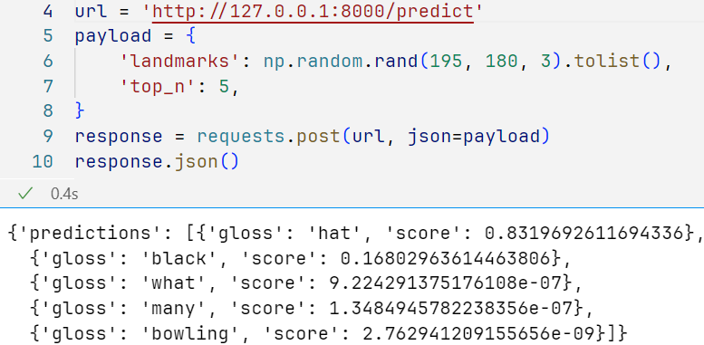
EXPERIMENTAL RESULTS
Sparse Dataset
4-6 Videos/Gloss
2-3s, depends on OpenAI’s side
Word-level & Pose-based Sign Language Interpreter
https://github.com/18520339/islr-mlops
Notes:
Building this solution wasn't without its challenges. Our most major problem was the sparse dataset. The WLASL dataset we used has 2000 classes but only 5-6 examples per word, making it tough for our model to learn effectively. We overcame this by applying data augmentation techniques like rotation and zooming, and by adapting a best model from the Kaggle competition, which boosted our accuracy. However, our top-1 accuracy was still just 61%, which wasn't ideal for reliable translation, so we innovated by using the top-5 predictions (86% accuracy)
Another challenge was achieving real-time performance. Through optimization, we already able to reduced our Pose-to-gloss model latency to under 1 seconds by using the key points and TFLite, ensuring a smooth user experience. However, the translation using GPT can be slow, like around 2s, making the whole process will cost the same number with the length of video. These challenges pushed us to think more creatively to find a better solution.

Slide 14
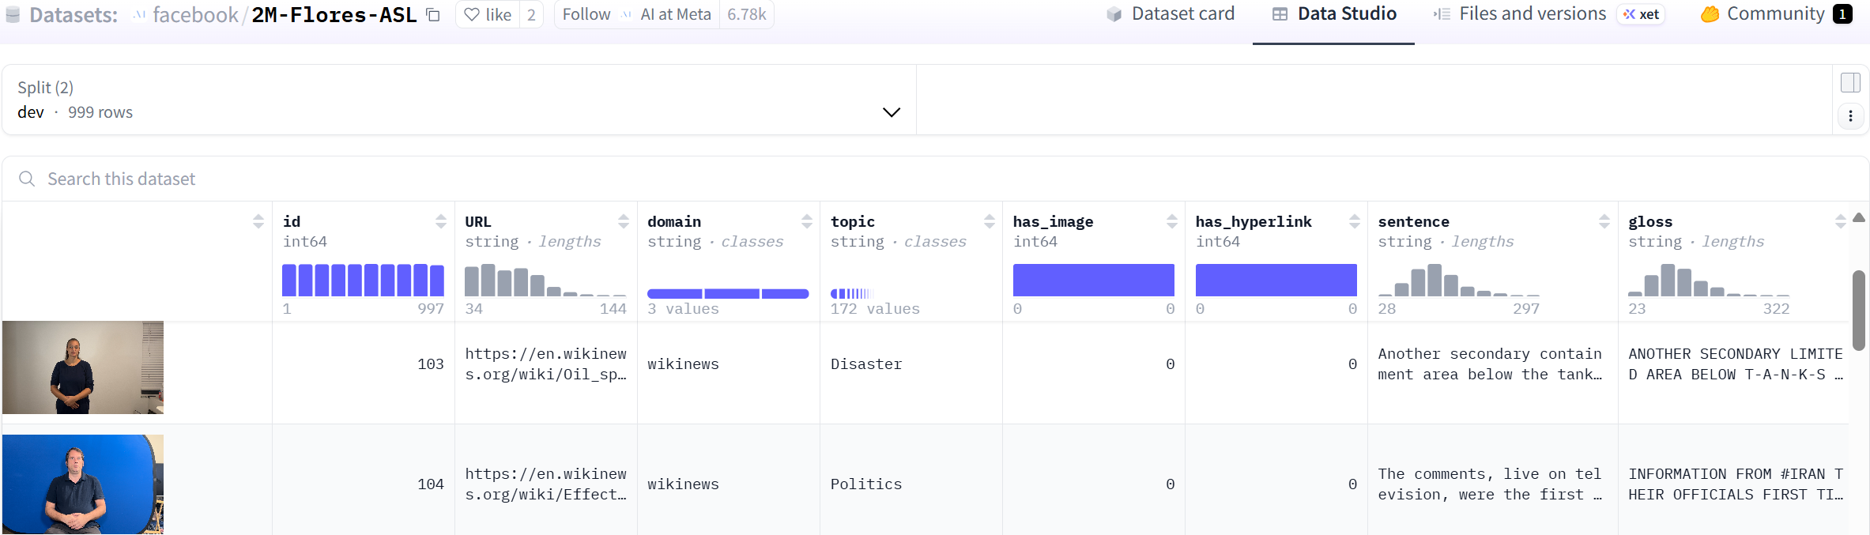
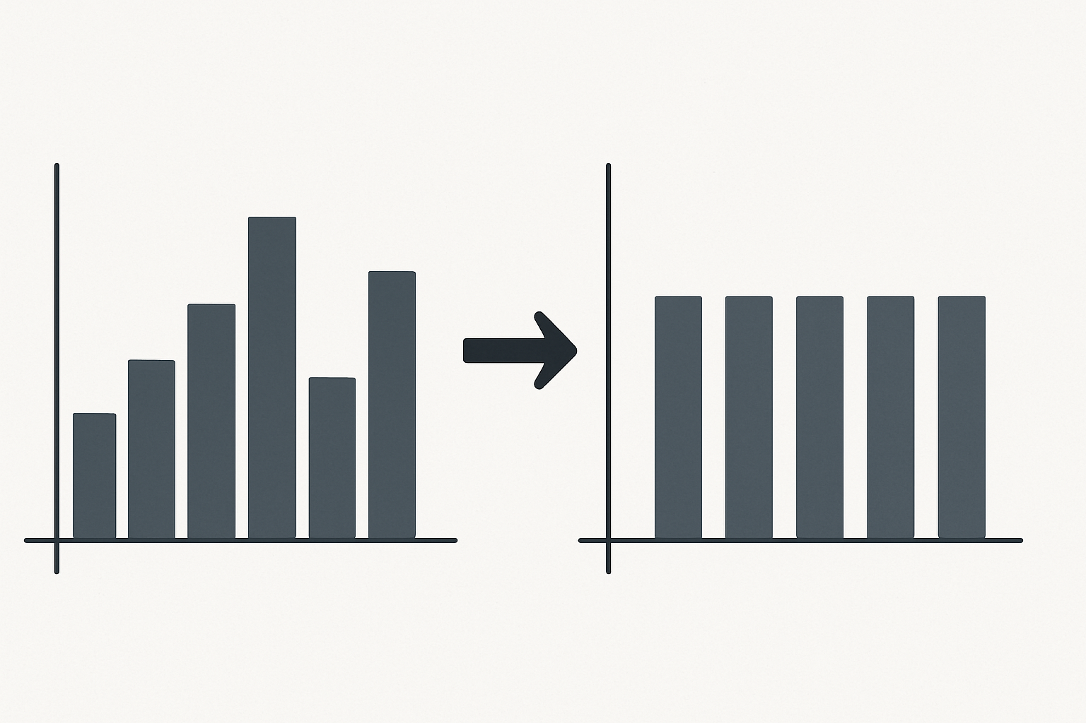
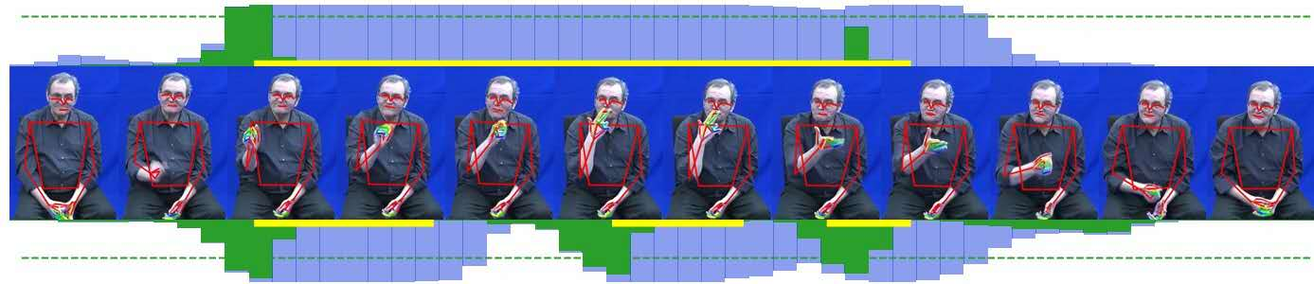
CONCLUSION AND FUTURE WORK
Larger
Dataset
Continuous
approach
Distribution
Start & End Detection
System
Gloss A
Gloss B
Gloss C
Gloss A
Gloss B
Gloss C
Top-N Gloss
Gloss A -> Gloss B (Beam Search)
Possible
Others: Multiple sign languages, Integrating with platforms, Multiple signers.
Word-level & Pose-based Sign Language Interpreter
https://github.com/18520339/islr-mlops
Notes:
We planned to further improve gloss-to-text part by utilizing the top_n paramaters to return different glosses with scores and letting the GPT decides the translations. We have this idea when reading about beam search
Lastly, the prediction problem is not exactly about the model, it's about how we handle a sequence of frames, which required the development of another model to perform the temporal segmentation to detect when a sign starts and ends, which we are currently put in the out-of-scope section in the product requirements.

Slide 15
THANK YOU FOR LISTENING

